Slide 1


Flight Price Prediction
Presented By
Shivanchal Asthana

Slide 2

Table of Content
Introduction
Benefits of House Price Prediction
Problem statement
Objectives
Research Methodology
Data Analysis/ Visualizations/ Observations
Conclusions

Slide 3

Introduction
Anyone who has booked a flight ticket knows how unexpectedly the prices vary. The cheapest available ticket on a given flight gets more and less expensive over time.
In this project, We use machine Learning algorithm to predict the right value of any flight with the available independent variables.

Slide 4

Benefits
Predicting flight prices helps anyone to know the right price of flight tickets and he/she will plan accordingly their visit or their budget.

Slide 5
About Problem Statement
Flight ticket prices can be something hard to guess, today we might see a price, check out the price of the same flight tomorrow, it will be a different story. We might have often heard travellers saying that flight ticket prices are so unpredictable.
Anyone who has booked a flight ticket knows how unexpectedly the prices vary. The cheapest available ticket on a given flight gets more and less expensive over time. This usually happens as an attempt to maximize revenue based on –
Time of purchase patterns (making sure last-minute purchases are expensive)
Keeping the flight as full as they want it (raising prices on a flight which is filling up in order to reduce sales and hold back inventory for those expensive last-minute expensive purchases)

Slide 6

Objectives
Create an analytical framework to understand
- Key factors impacting flight price
Develop a modelling framework
- To estimate the price of a flight that is expansive or not

Slide 7
Research Methodology
The research methodology adopted for this is given as follows:
Research design: The research design adopted for this study is descriptive research design. The descriptive research design focuses on the accurate description of the variables present in the problem.
Sampling: Sampling allows concentrating upon a relatively smaller number of people and hence, to devote more energy that the information collected from them is accurate.
Sampling Size: The total size of the sample is 269 respondents.

Slide 8
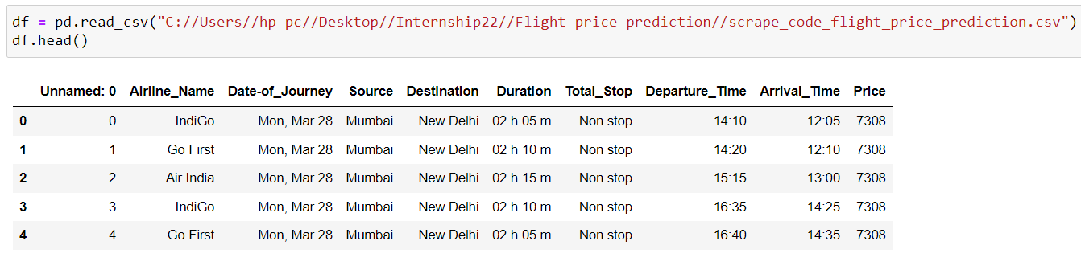
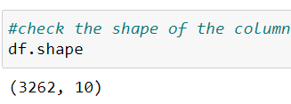
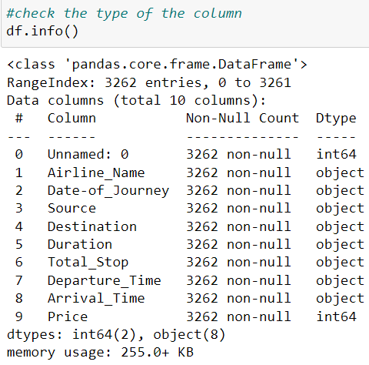
Data Analysis and Interpretation
Scrapped CSV File
Dataset contains 3262 rows and 10 columns.
All the columns are in object form except label column which is in string.

Slide 9
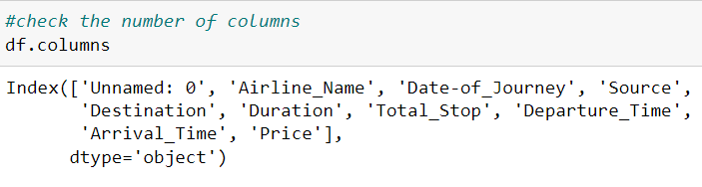
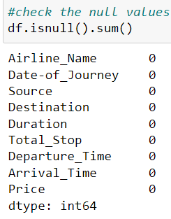
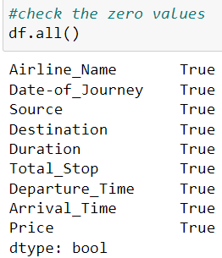
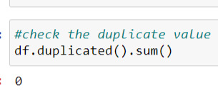
Data Understanding
No null values are found
No zero values are found
No duplicate values are found

Slide 10
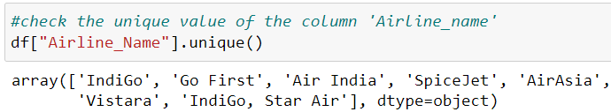
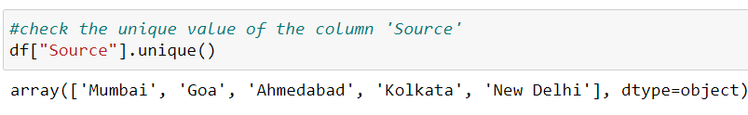
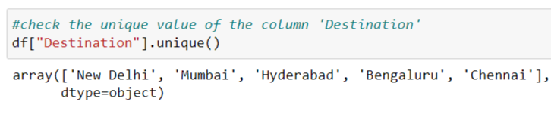
Data Understanding
We see, there are 7 airline names in this dataset
Source and Destination are major 5 cities

Slide 11
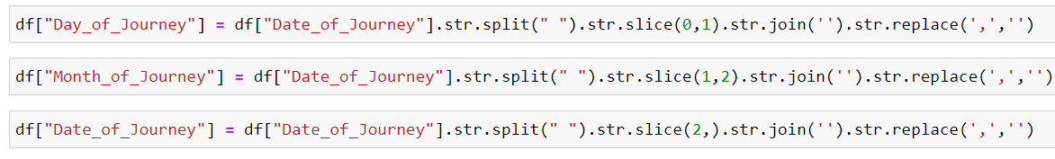
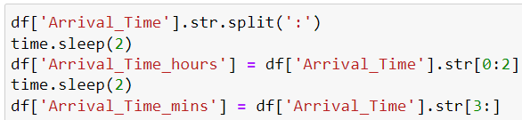
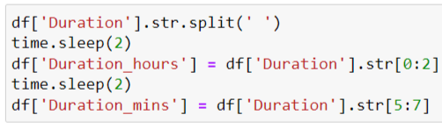
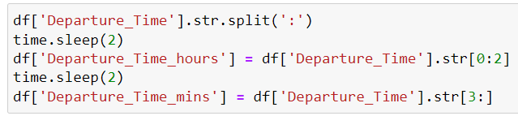
Data Cleaning
1. We split these columns into 2 or 3 parts. We use split, join and replace command to clean these columns.

Slide 12
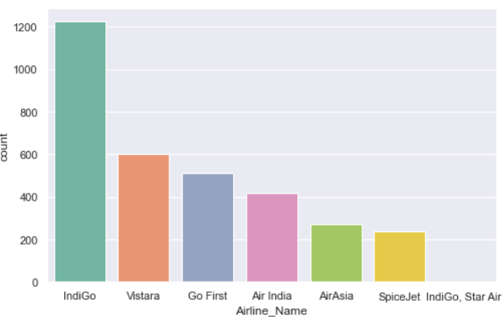
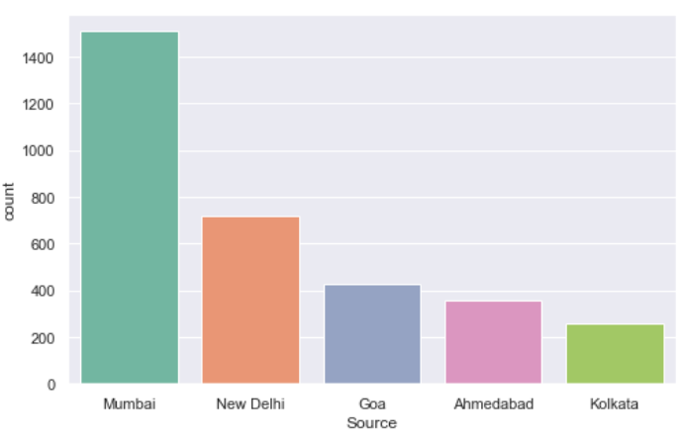
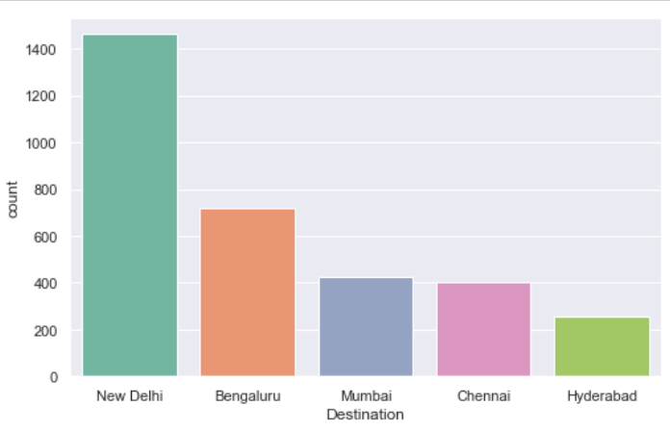
Data Analysis
1. We see here, IndiGo flights are more then any other flights, there is only one IndiGo, Star Air, As we observe the count plots, flights in ```Mumbai``` is more then others as a Source. On the other hand, Delhi is more then others as a destination of flights.

Slide 13
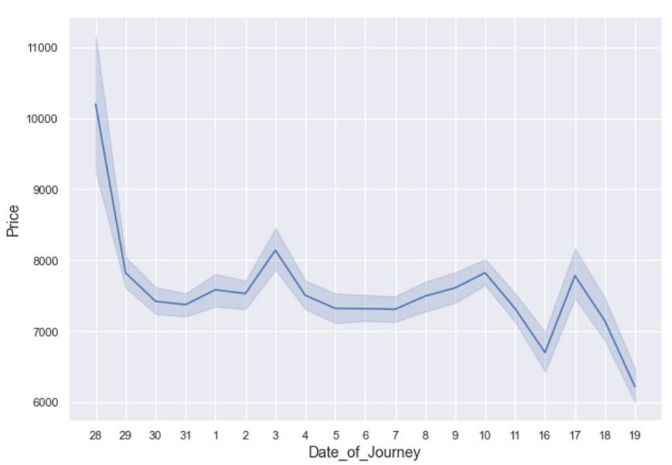
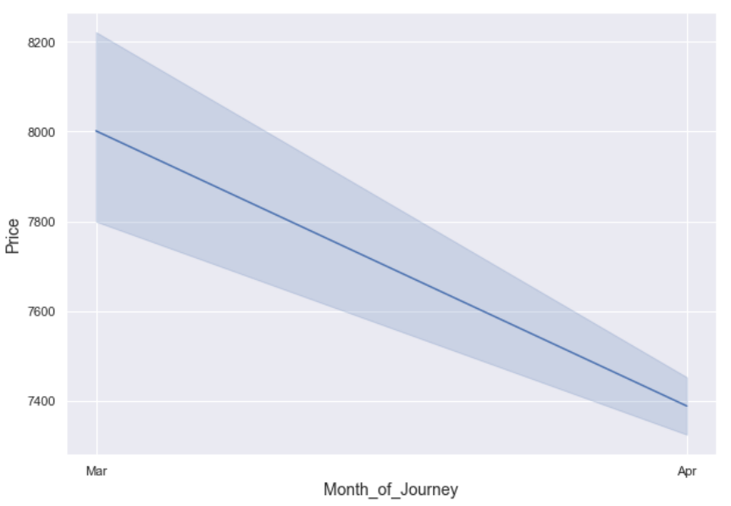
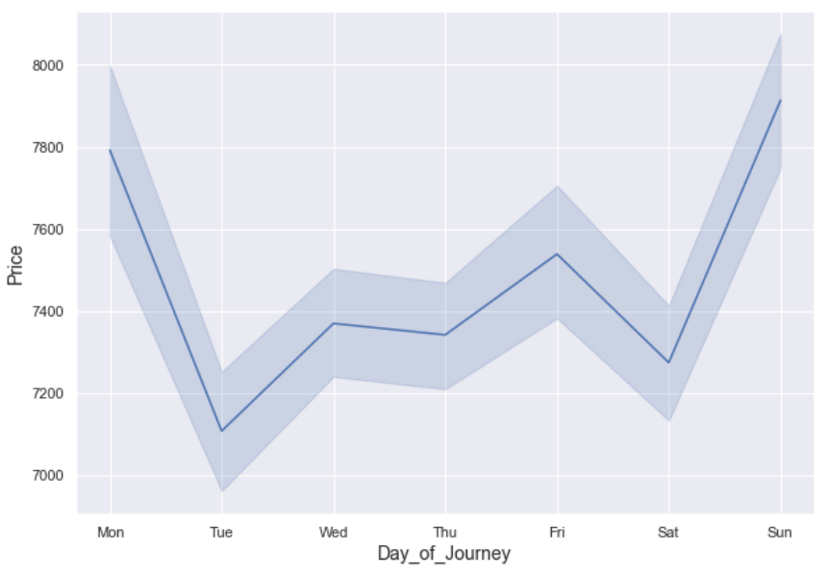
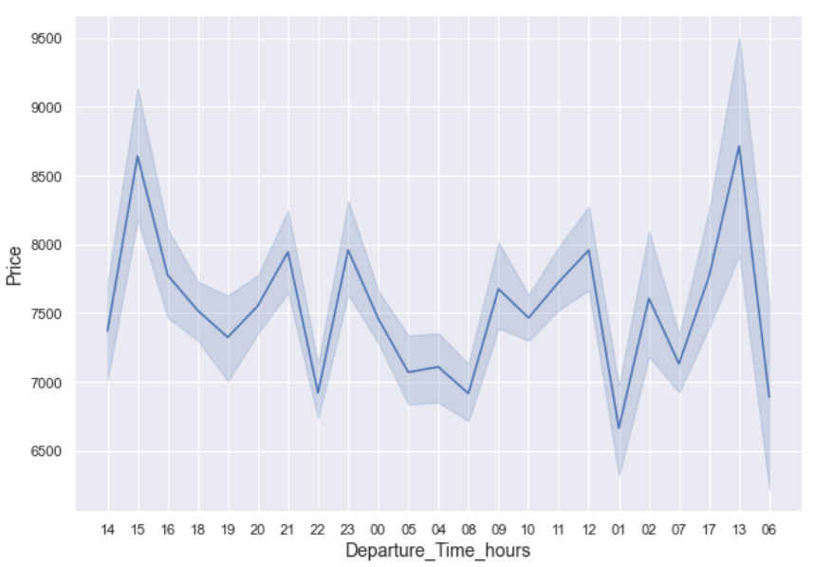
Data Analysis
Price is more as we book any flight on immediate basis.
Price are go down when we book ticket after 15-20 days.
Prices are more on weekends than weekdays.
Afternoon and evening flights are more expansive than morning flights.

Slide 14
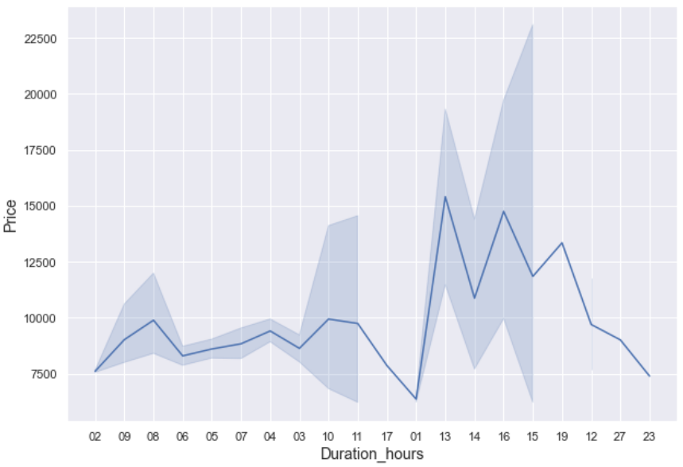
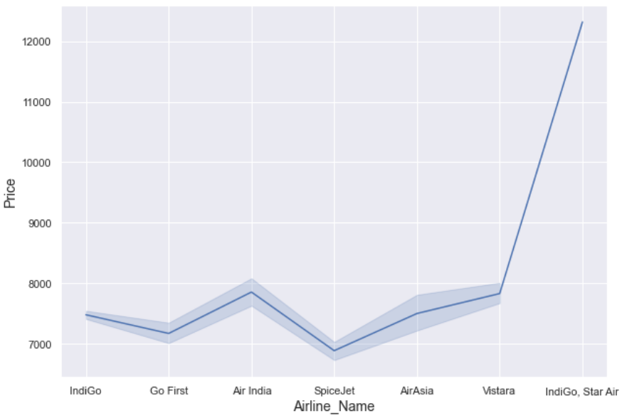
Data Analysis
As we see, if duration of hours increases, prices are increases.
SpiceJet price is lesser than IndiGo

Slide 15
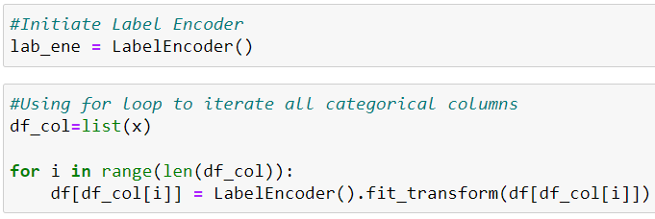

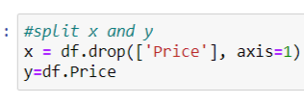

Encoding Shuffling Drop Label
We use LabelEncoding to convert all categorical columns into Numerical form.
We Shuffle all rows in our dataset.
Drop the price column into y and save rest columns into x.

Slide 16
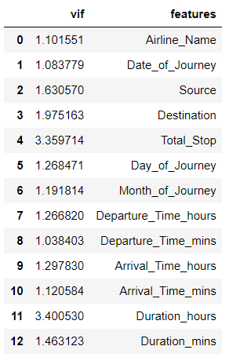
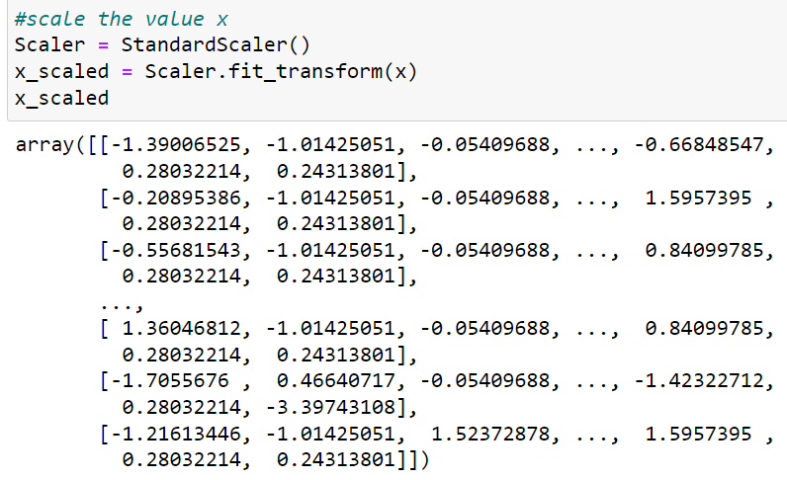
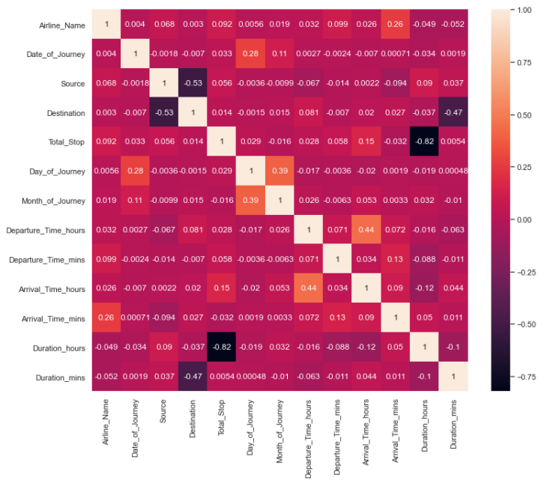
Scalling & Multicollinearity
We check the multicollinearity by using Heatmap and VIF
We see, there is no multicollinearity exist.
So, we scale the data by using StandardScalling.

Slide 17
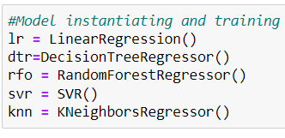
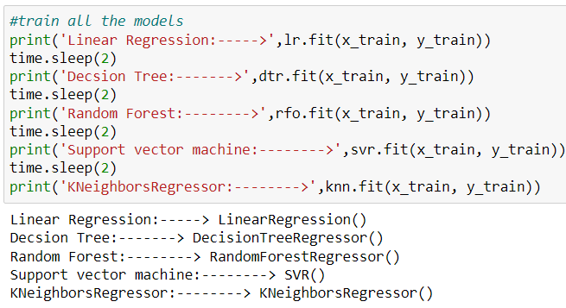
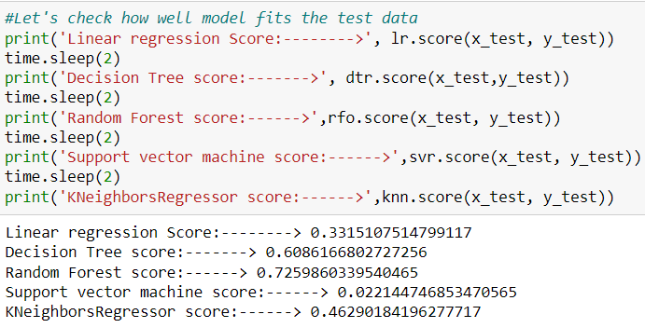
Models
1. We use 5 modals here- Linear Regression, decision Tree Regressor, Random Forest Regressor, SVR and KNNRegressor.
Random Forest Regressor is giving us more accuracy than others.

Slide 18
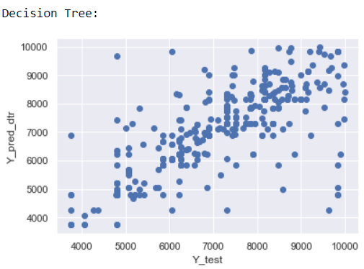
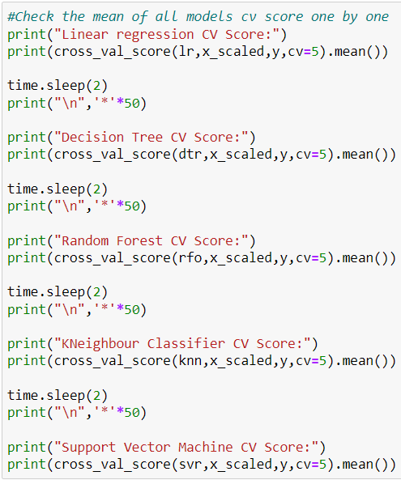
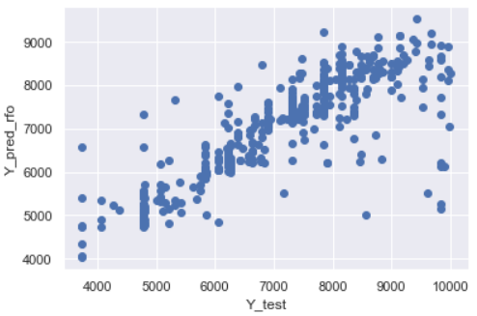
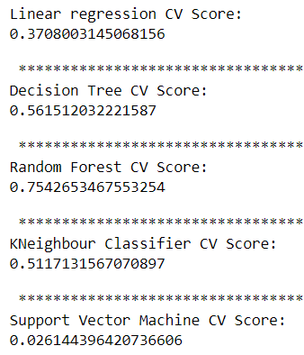
CV Score & Plot of Actual and Predicted Value
By using Cross validation, Random forest is giving us better accuracy than others.
So, we can neglect Other Modals because they gives us poor accuracy.
We see here, randomforest is giving us better plot than decision Trees

Slide 19
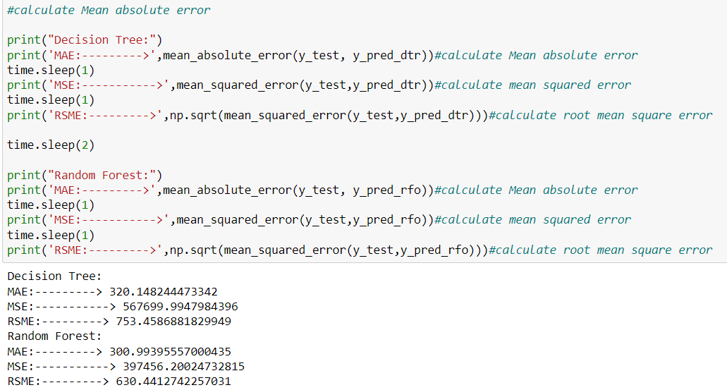
MAE,MSE, RSME
1. RandomForest is giving us better error values than decision Tree

Slide 20
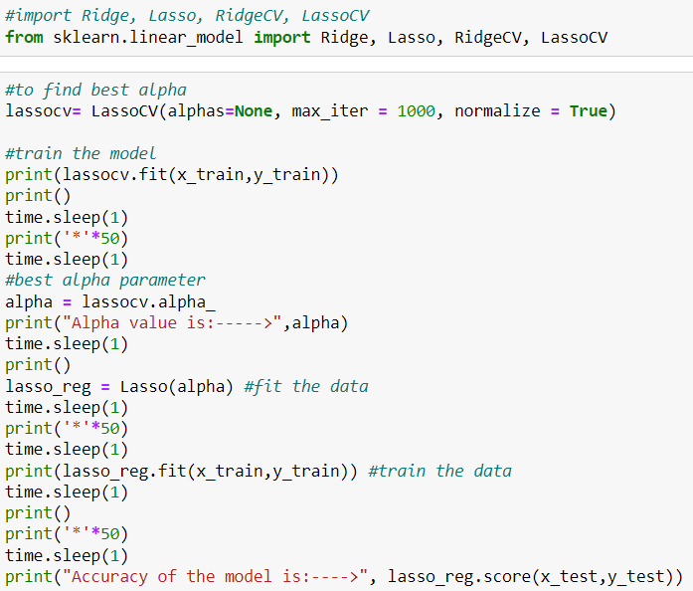
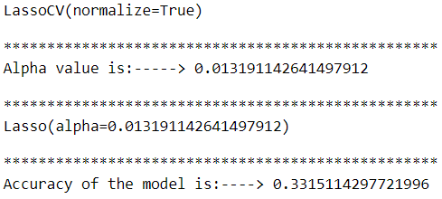
Lasso Regression
. Lasso regression both are giving us poor accuracy.

Slide 21
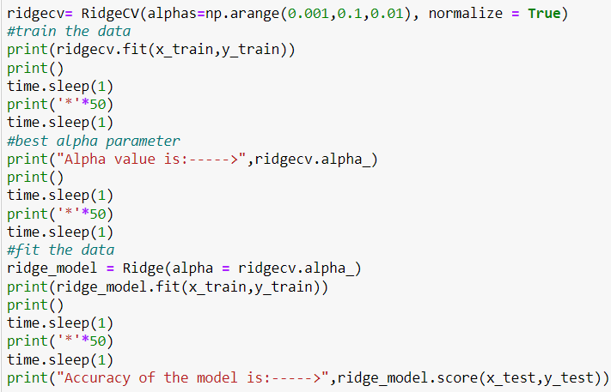
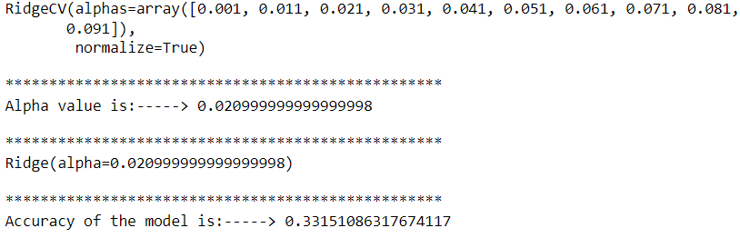
Ridge Regression
. Ridge regression both are giving us poor accuracy.

Slide 22
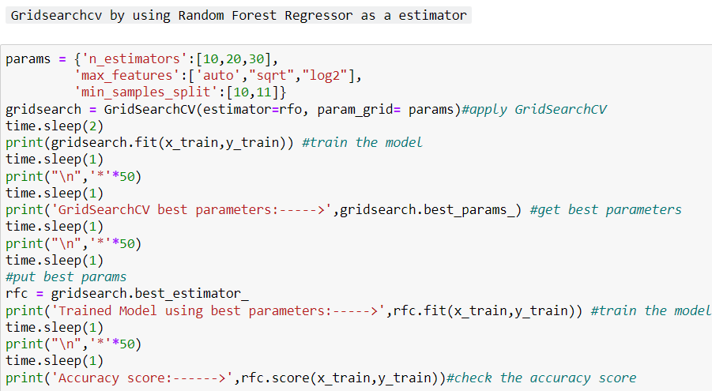
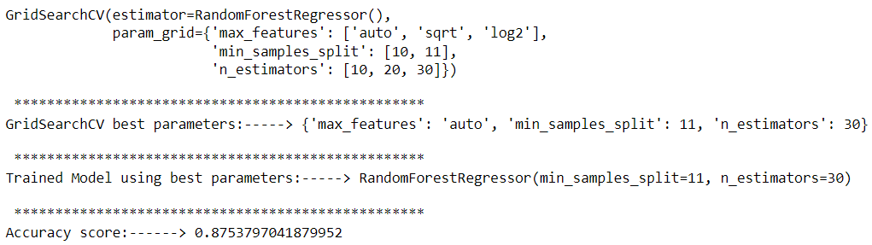
GridSearchCV on RandomForest
1. By using GridSearchCV on RandomForest, We increases our accuracy from 75% to 87%.

Slide 23
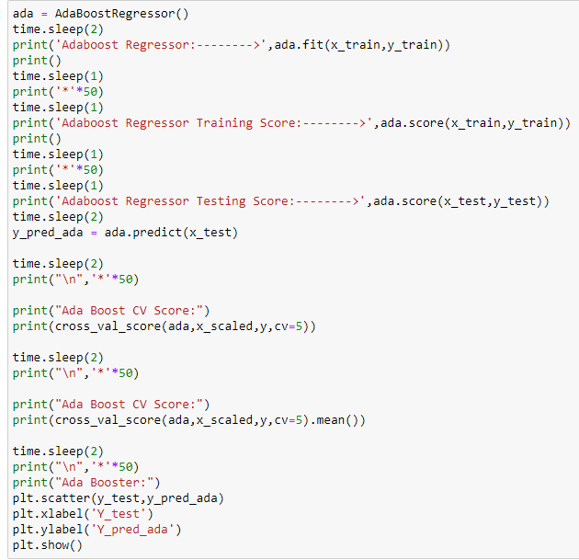
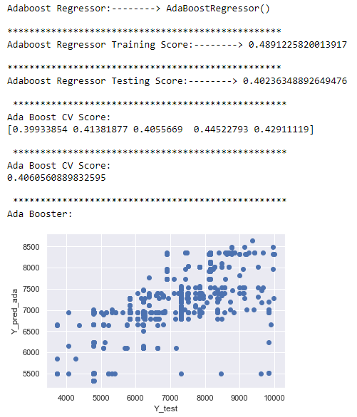
AdaBoost Regressor
1. AdaBoost Regressor is giving us 48% Accuracy.

Slide 24
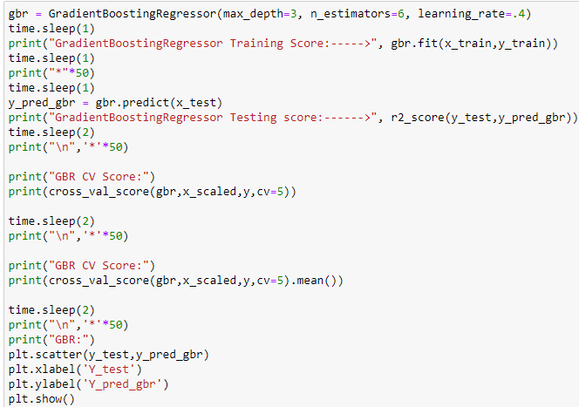
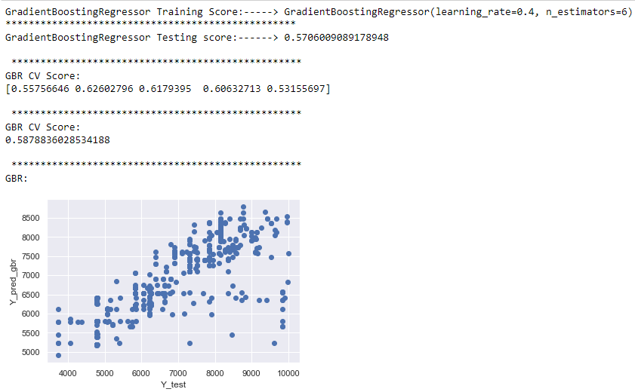
Gradient Boosting Regressor
1. GradientBoostingRegressor is giving us 58% accuracy.

Slide 25
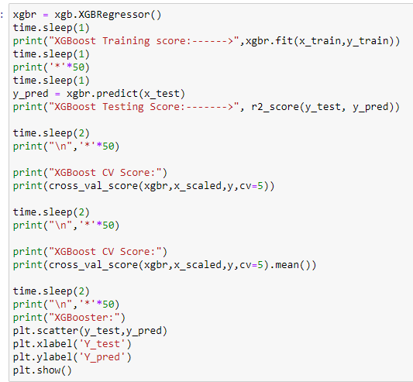
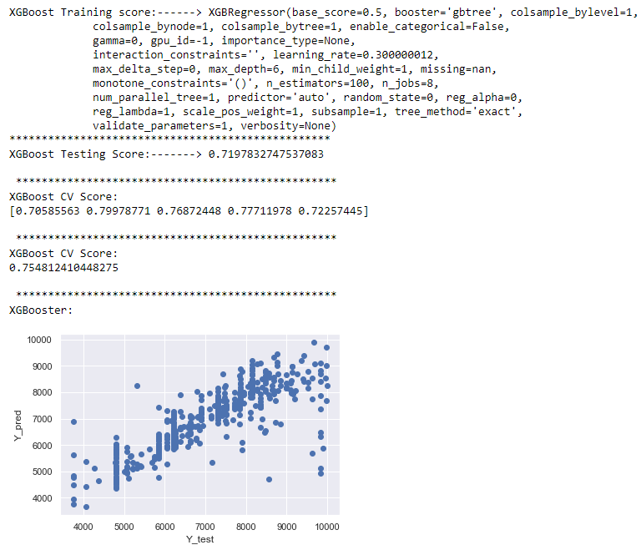
XGBoost Regressor
XGBoost is giving us 75%% accuracy.

Slide 26
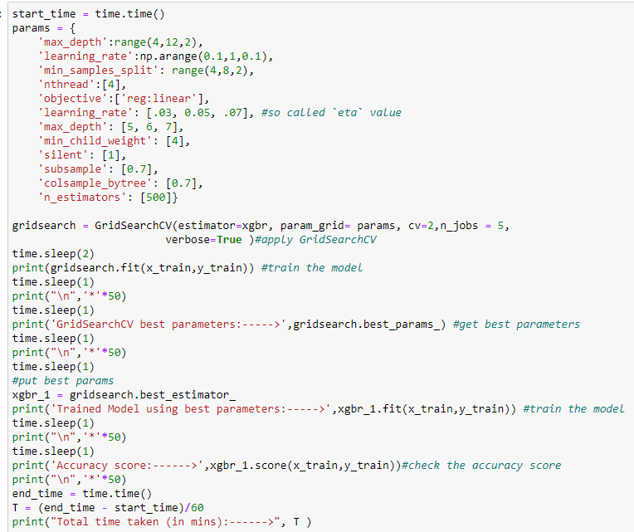
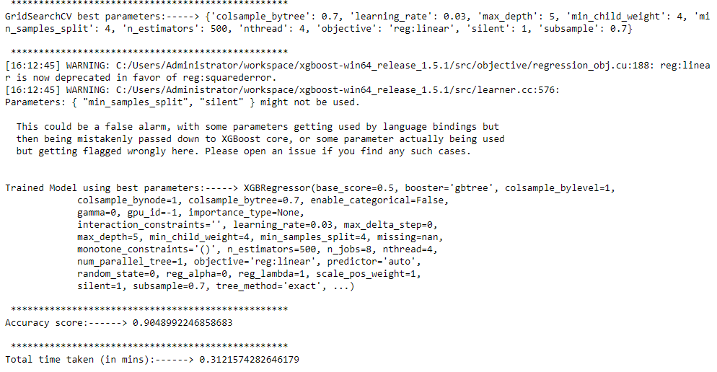
GridSearchCV on XGBoost
1. On using GridSearchCV on XGBoost, We increase accuracy from 75% to 90%.

Slide 27


Saving best model & Conclusion
1. We see, XGBoost is giving us 90% Accuracy when we apply gridsearchcv on it. SO, this is our best model.

Slide 28
THANKYOU

